Slide 1
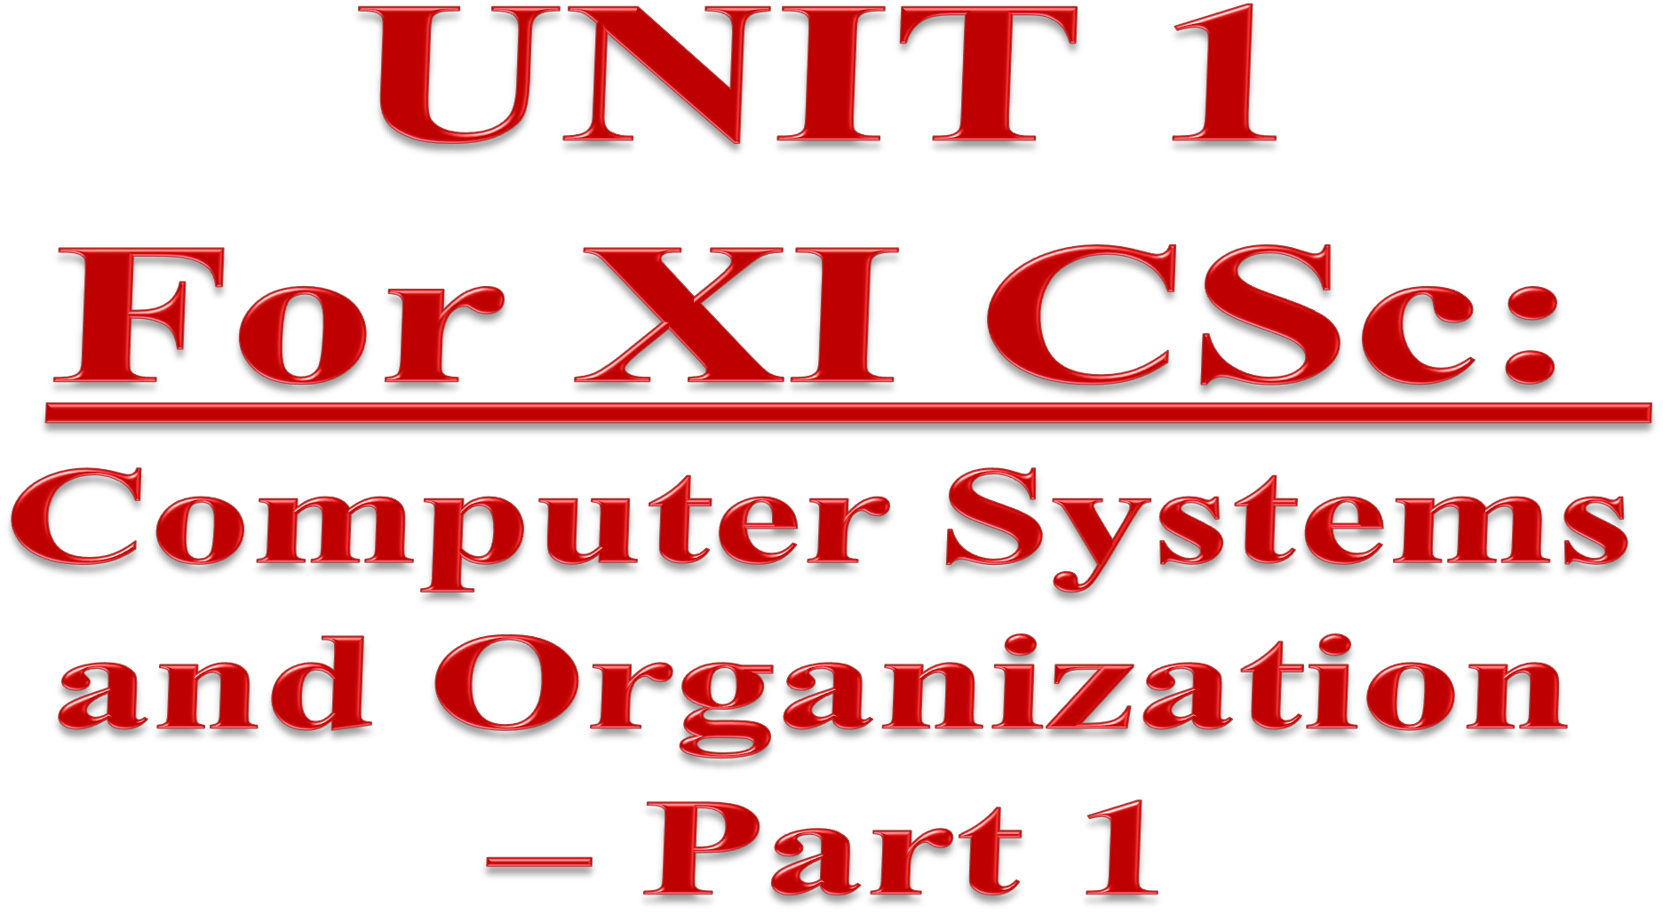


Slide 2

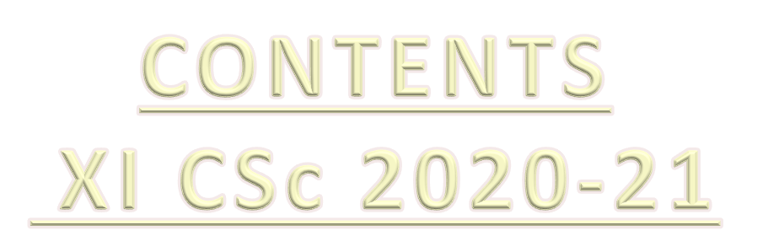
Unit I: Computer Systems and Organization
Part-1
Basic computer organization: description of a computer system
and mobile system, CPU, memory, hard disk, I/O, battery.
Types of software: Application software, System software and Utility software.
Memory Units: bit, byte, MB, GB, TB, and PB
Concept of Compiler and Interpreter
Operating System (OS) - need for an operating system, brief introduction to functions of OS, user interface

Slide 3
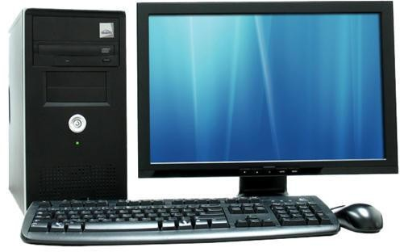
What is a COMPUTER ????
Computer is an advanced electronic device that takes raw data (input) from the user and
processes these data under the control of set of
instructions (called program) and gives the result (output) and saves output for the future use.

Slide 4
STRENGTH of a computer
Versatile
Accuracy
Speed
Reliable
Memory
Weakness of a Computer
Lack of IQ (Intelligent Quotient)
Needs power supply
Lack of Decision making power/ Computers can’t think

Slide 5
Uses of a computer
Weather Forecasting
Railways/Airports
Scientific research
Business organizations/Offices
Banks
Medical Field
Entertainment/Media/Cartoon industry
Schools/Colleges/Universities
Defence

Slide 6
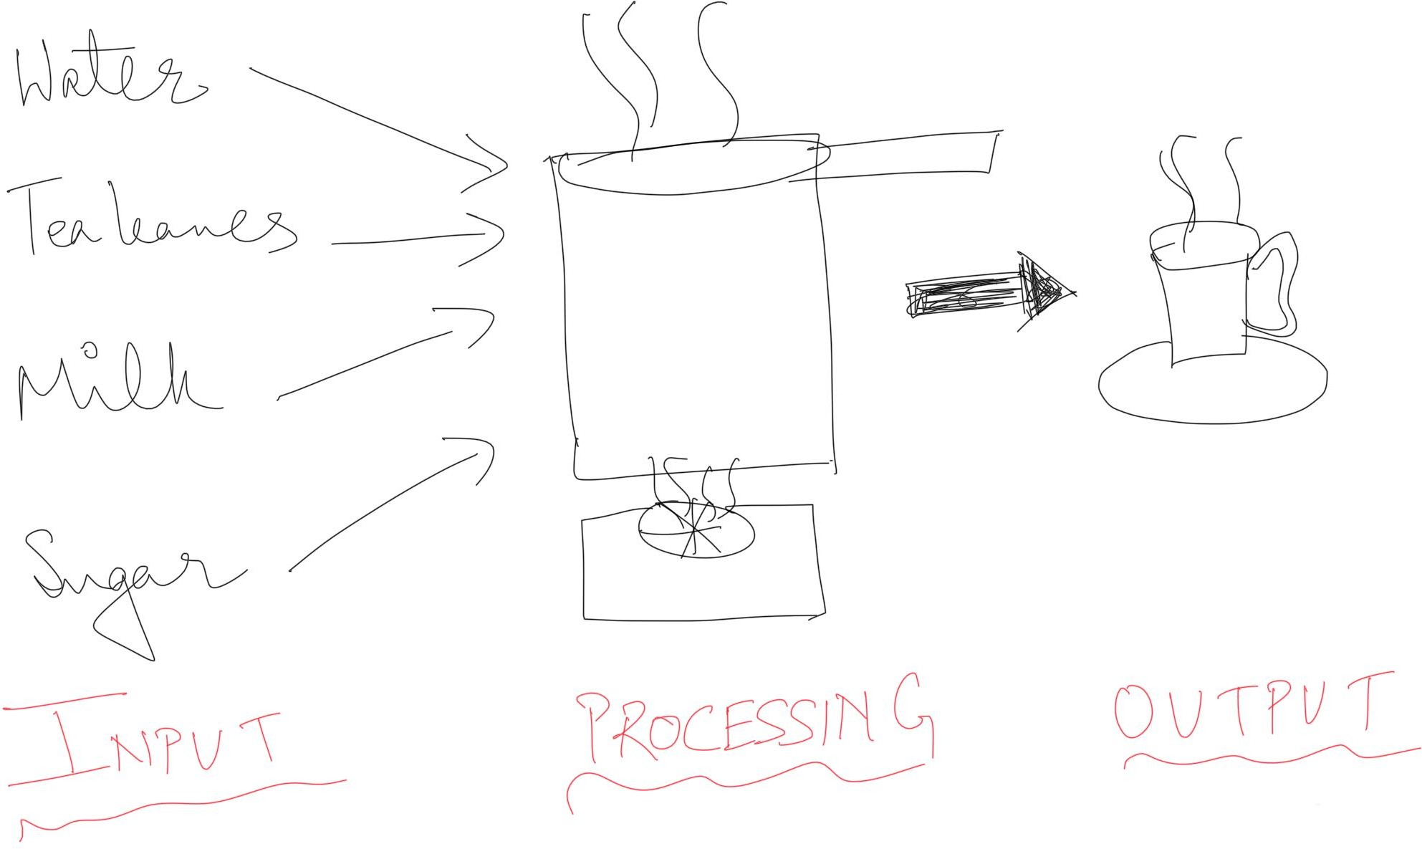



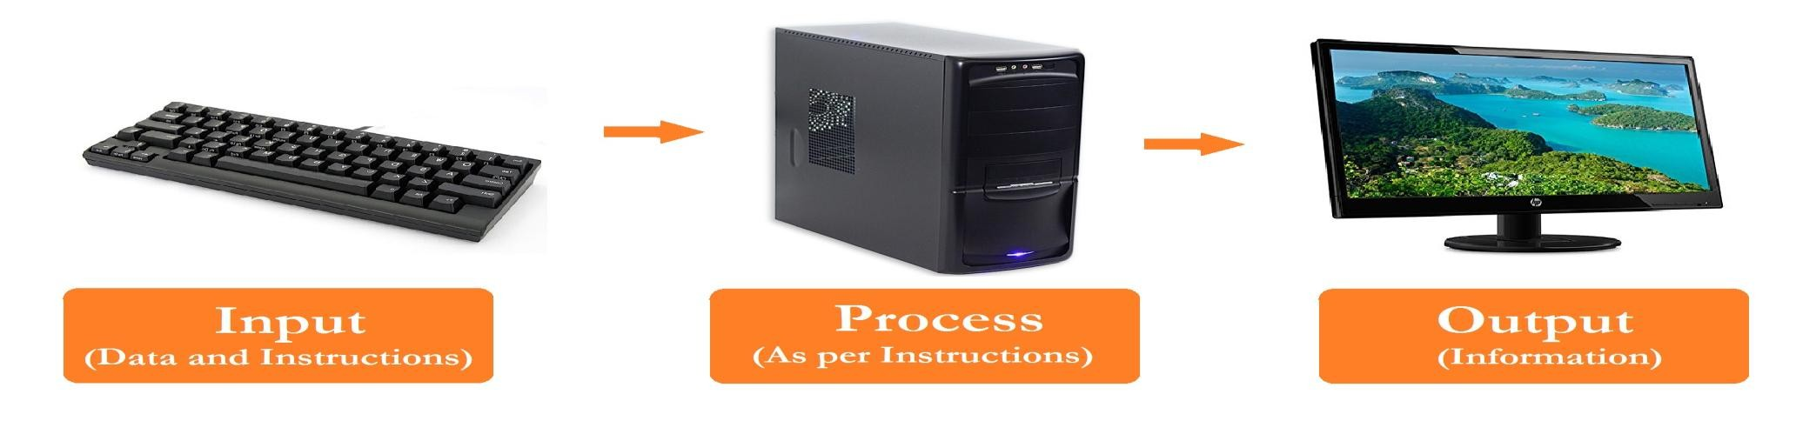
IPO Cycle
Sets of Instruction (PROGRAM)
1.
2.
3.
4.
5.
Input
Processing
Output

Slide 7
Data and Information
DATA | INFORMATION
Raw facts and figures | Processed data
May or may not be meaningful | Always meaningful
User input | Output to the user
What is a System?
System is a set of rules, an arrangement of things, or a collection of elements or components that work towards a common goal/purpose in an organized manner.
What is a PROGRAM?
– Set of instructions

Slide 8
Hardware and Software
Hardware
Physical parts of a computer system which can be seen and touched and which can undergo wear and tear.
  Peripherals
Physical parts which are kept in the surroundings of a computer system. Eg- Keyboard , Mouse, Speaker, Printer etc.
Software
Set of programmes /instructions which helps in the working of computer and related devices.
Eg- Python Interpreter, Browsers (Eg. Firefox),OS(Eg.Windows10) ,Games,Apps etc.
Firmware
Prewritten programme which is permanently stored in ROM-BIOS(Read Only Memory- Basic Input Output Services ). It is used in configuring the computer system.
Live ware-
  People related to the computer system
  Eg.Users, Programmers

Slide 9
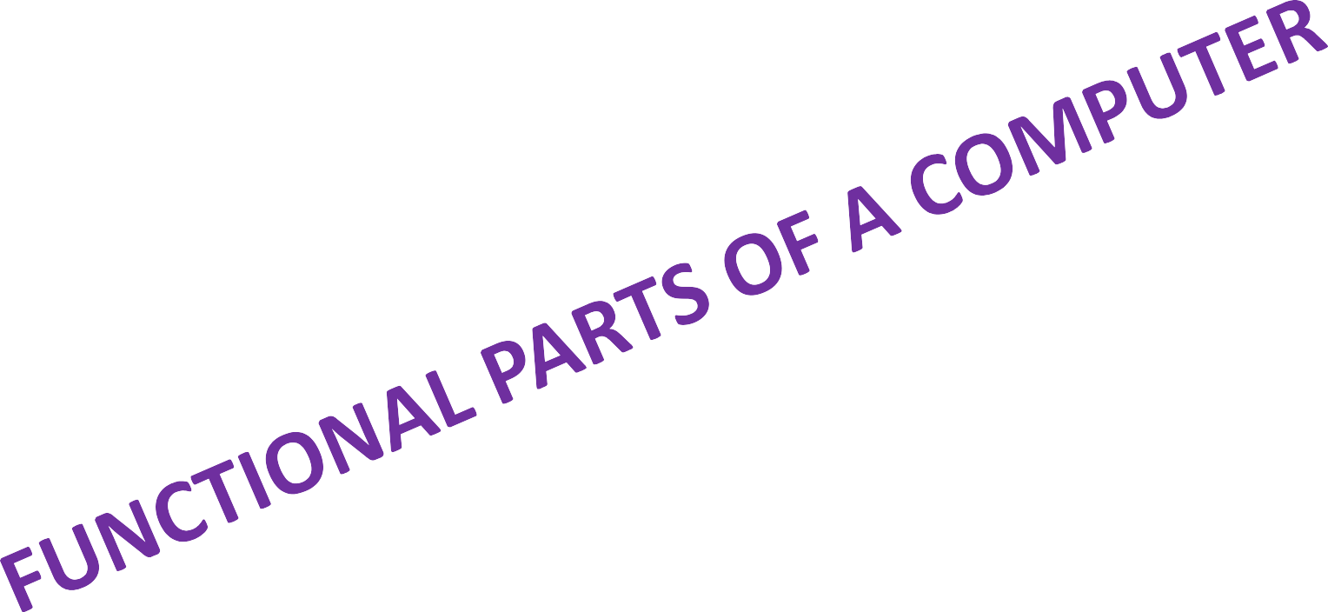
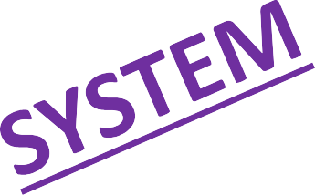

Slide 10
CPU
INPUT
Keyboard
Mouse
Scanner
Joystick
Web Cam
Microphone
Digitizer Tablet
Digital camera
Touch Screen
Track Ball
MICR
OCR
OMR
Barcode Reader
Smart Card Reader
OUTPUT
Monitor
Printer
Speaker
Projector
Plotter
ALU
CU
PRIMARY / MAIN / INTERNAL MEMORY
(RAM,ROM,CACHE Memory)
SECONDARY / AUXILLARY / EXTERNAL MEMORY
(Hard disk, CD, DVD, Blue Ray Disc, Pen Drive, Magnetic Tape Drive, Memory Cards, Memory Stick etc.)

Slide 11
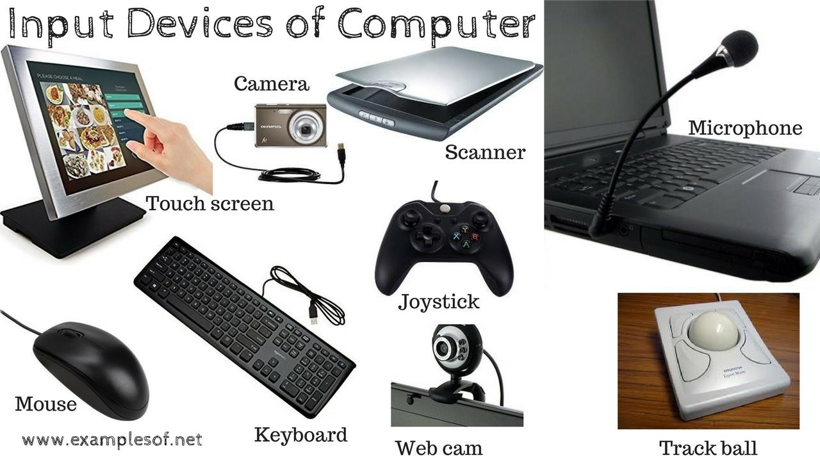
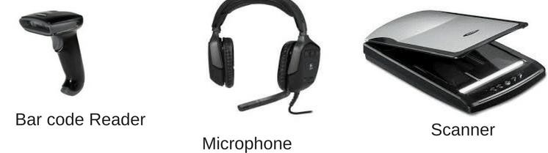
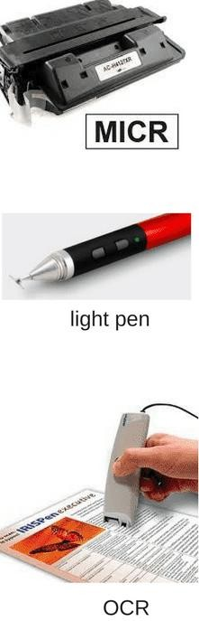
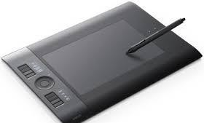
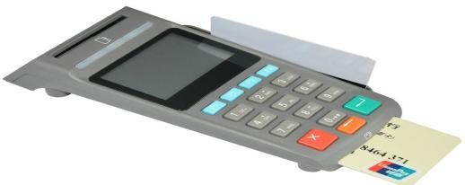
Functional components of a computer system→
INPUT UNIT
An input device is any device that provides input to a computer. It accepts input from the Input Unit and converts it into computer understandable form(binary form).
Digitizer tablet/Writing pad
Smart card reader

Slide 12
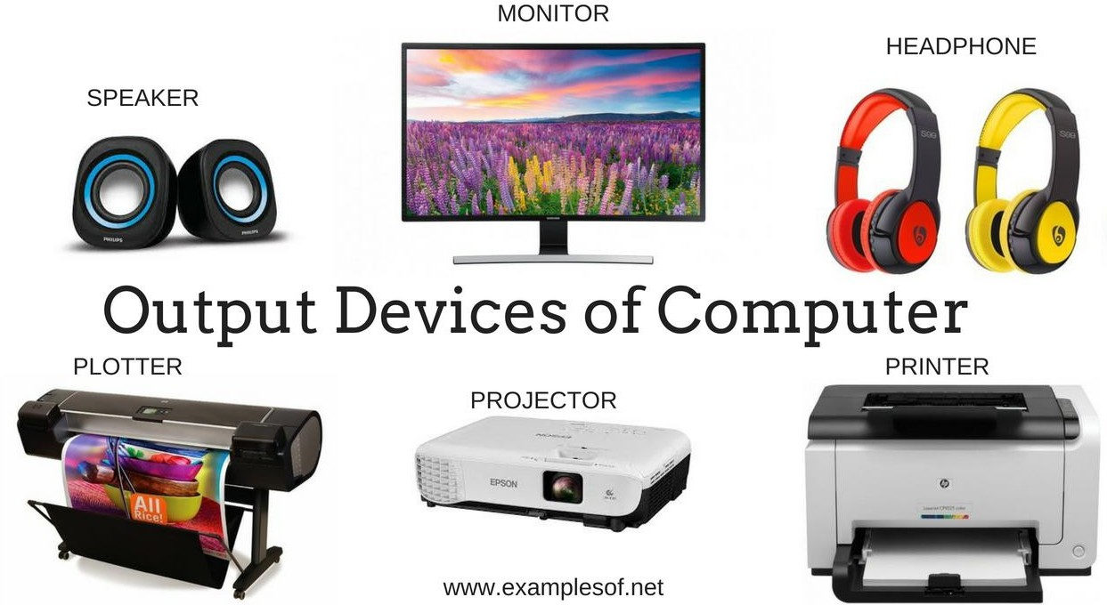
Functional components of a computer system→
OUTPUT UNIT
An Output device is any device that provides output in a form which is human understandable (Audio, Video, printed form). This conversion from machine understandable form to human understandable form is the work of Output unit.
NOTE: Computer understands only two signals viz. 1(ON) and 0(OFF).
Since, there are only two digits/signals which computer understands ,therefore, this machine level language is also known as Binary Level Language.

Slide 13
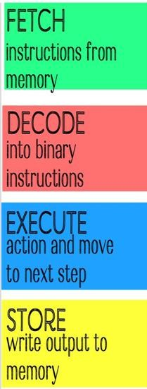
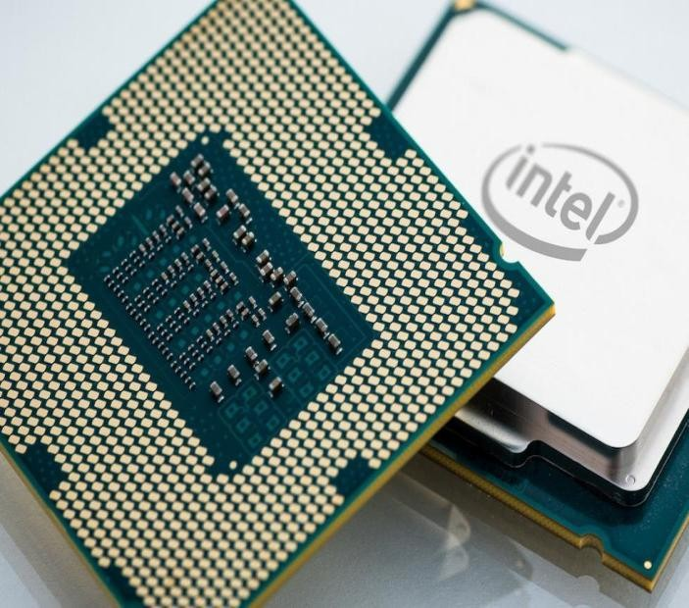
Functional components of a computer system→
CENTRAL PROCESSING UNIT (CPU)
Central Processing Unit (CPU) is also known as microprocessor or processor. A CPU is brain of a computer. It is responsible for all functions and processes. The CPU is the most important element of a computer system which guides, directs ,controls and governs the performance of a computer.
Function of the CPU → The CPU processes the instructions it receives from input devices and gives the required output using output devices. CPU has four basic functions to perform a task:

Slide 14
Functional components of a computer system→
Parts of (CPU) : ALU,CU,Registers
Arithmetic Logic Unit (ALU)
The electronic circuitry in ALU executes all arithmetic and logical operations.
It performs arithmetic calculations like ARITHMETIC(+, - , *, /) as well as LOGICAL comparisons (<, >, <=, >=,=, !=) which returns only True or False.
The unit can compare numbers, letters, or special characters.
Control Unit(CU)
The circuitry in the control unit uses electrical signals to instruct the whole
computer system for carrying out or executing already stored program instructions.
It controls , guidesand co-ordinates computer components.
Control Unit acts like the nervous system of the entire computer which receives(FETCH), decodes (DECODE), stores results (STORE) and manages execution
(EXECUTE) of data that flows through the CPU.
Its communicates with both arithmetic unit and memory unit.
Registers/ Processors Registers
Registers are temporary storage areas which are responsible for holding the data that is to be processed .They store the processing information (instructions, data or
memory addresses), when processing takes place in a processor. This data is further used by Control Unit.

Slide 15


Slide 16
Functional components of a computer system→
MEMORY UNIT
It refers to the physical devices used to store programs (sequences of instructions) or data (e.g. program state information) on a temporary or permanent basis for use in a computer or other digital electronic devices. Computer understands only two states, ON(1) and OFF(0), which are represented by only two digits 1 and 0 and referred as BINARY DIGITS or BITS.
Each cell contains one bit of information i.e (0 or 1) OFF or ON
All the words are of equal word length.
If m=64 bits i.e. word length is 64 bits then we say that it is a 64 bits memory.
If N no. of addresses are there then the addressing starts from 0 to N-1
The total no. of cells will be= (N * m) no. of cells

Slide 17
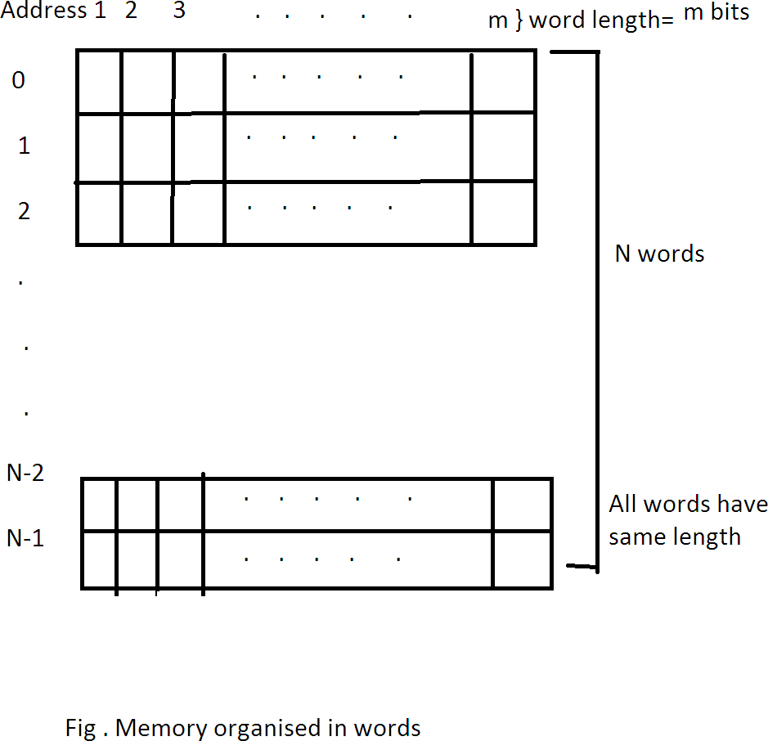
1 0 1

Slide 18
UNITS OF COMPUTER MEMORY MEASUREMENTS
UNIT | Short name/ Equivalent higher unit
1 Bit | Bit (Binary Digit)
4 Bits | 1 Nibble = ½ Byte
8 Bits | 1 Byte
1024 Bytes= 2¹⁰ Bytes | 1KB (Kilo Byte)
1024 KB = 2¹⁰ KB | 1MB (Mega Byte)
1024 MB= 2¹⁰ MB | 1GB (Giga Byte)
1024 GB = 2¹⁰ GB | 1TB(Tera Byte)
1024 TB = 2¹⁰ TB | 1PB(Peta Byte)
1024 PB = 2¹⁰ PB | 1EB(Exa Byte)
1024 EB = 2¹⁰ EB | 1ZB(Zetta Byte)
1024 ZB = 2¹⁰ ZB | 1YB(Yotta Byte)
1024 YB = 2¹⁰ YB | 1 Bronto Byte
1024 BrontoByte | 1 Geop Byte

Slide 19




















Functional components of a computer system→
MEMORY UNIT
MEMORY UNIT
PRIMARY / MAIN MEMORY
SECONDARY MEMORY
CACHE
MEMORY
ROM
RAM
FLASH MEMORY
OPTICAL DISCS
MAGNETIC MEMORIES
SSD
HARD DISK
PROM
SRAM
PENDRIVE
CD
MAGNETIC
TAPES etc.
EPROM
DRAM
DVD
EEPROM
BLU-RAY
DISC
EAPROM

Slide 20
Functional components of a computer system→
(MAIN / PRIMARY) MEMORY UNIT
Memory refers to the physical devices used to store programs (sequences of instructions) or data (e.g. program state information) on a temporary or permanent basis for use in a computer or other digital electronic device.
The term primary memory is used for the information in physical systems which function at high-speed (i.e. RAM), as a distinction from secondary memory, which are physical devices for program and data storage which are slow to access but offer higher memory capacity. The Primary Memories are: RAM,ROM,Cache Memory(Part of Cache made up of high speed RAM) Extra Note: Primary memory stored on secondary memory is called "virtual memory".
Volatile memory is computer memory that requires power to maintain the stored information. RAM is volatile.
Non-volatile memory is computer memory that can retain the stored information even when not powered. ROM is non-volatile.

Slide 21
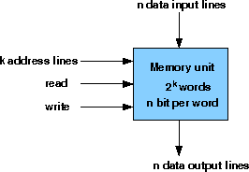
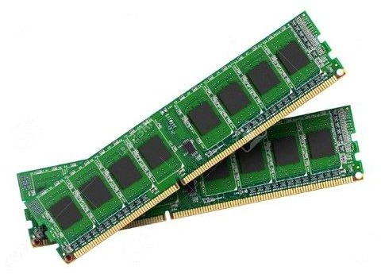
RAM (Random Access Memory)
Can be both read and write.
Hold the programs, operating system, and
data required by the system.
Generally volatile, meaning that it does not retain the data stored in it when the system 's power is turned off.
A Data that needs to be stored while the system is off must be written to a permanent storage device , such as a flash memory or hard disk.
An example is as follows: A mobile phone has128 KB or 256 KB of RAM to hold the stack and temporary variables of the programs, operating system, and data.
RAM memory is volatile.
Two basic types of RAM chips:
Dynamic RAM(DRAM)
Static RAM (SRAM)
8 GB DDR4 RAM image

Slide 22
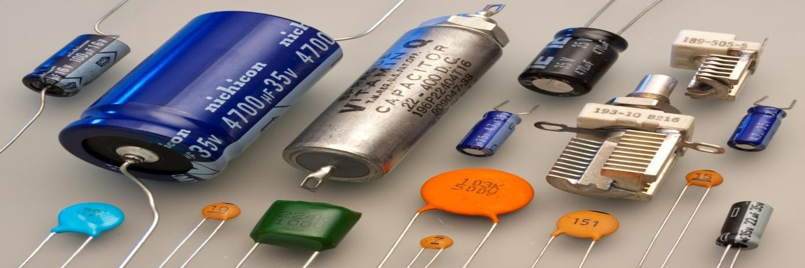
Dynamic RAM (DRAM)
Dynamic random-access memory (DRAM) is a type of random-access
memory that stores each bit of data in a separate capacitor within an integrated circuit.
The capacitor can be either charged or discharged; these two states are taken to represent the two values of a bit, conventionally called 0 and 1.
Since capacitors leak charge, the information eventually fades unless the capacitor
charge is refreshed periodically.
Because of this refresh requirement, it is a dynamic memory as opposed to SRAM and other static memory.
The transistors and capacitors used are extremely small; billions can fit on a single memory chip.
DRAM is volatile memory , since it loses its data quickly when power is removed.
Image of Capacitors

Slide 23
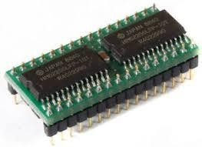
Static RAM(SRAM)
Static random-access memory (SRAM) is a type
of semiconductor memory that are made up of flip-flops (a binary cell capable of storing one bit of information) to store each bit.
The term static differentiates it from dynamic RAM (DRAM) must be
periodically refreshed.
SRAM exhibits data remanence, but it is still volatile in the conventional sense that data is eventually lost when the memory is not powered.
SRAM is more expensive and are used in specialized applications and less dense than DRAM and is therefore not used for high-capacity, low-cost applications such as the main memory in personal computers.
SRAM is also used in personal computers, workstations, routers and peripheral equipment: CPU register files, internal CPU caches and external burst mode SRAM caches, hard disk buffers, router buffers, etc.
LCD screens and printers also normally employ static RAM to hold the image displayed (or to be printed).
Image of SRAM

Slide 24
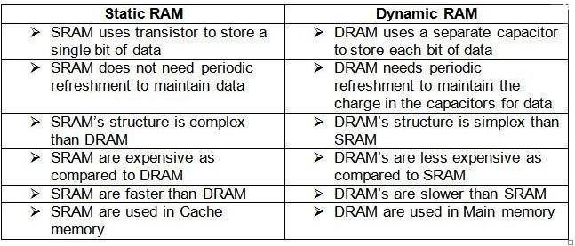
STATIC RAM Vs DYNAMIC RAM

Slide 25
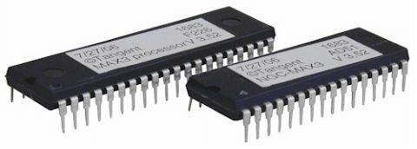
Read Only Memory (ROM)
Read-only memory (ROM) is a class of storage medium used in computers and other electronic devices. Data stored in ROM cannot be modified, or can be modified only slowly or with difficulty, so it is mainly used to
distribute firmware (software that is very closely tied to specific hardware, and unlikely to need frequent updates).

Slide 26
TYPES OF ROM
ROM | ROM refers only to mask ROM (the oldest type of solid state ROM), which is fabricated with the desired data permanently stored in it, and thus can never be modified.
PROM | (PROM), or one-time programmable ROM , can be written to or programmed via a special device called a PROM programmer. Typically, this device uses high voltages to permanently destroy or create internal links (fuses or antifuses) within the chip. Consequently, a PROM can only be programmed once.
EPROM | Erasable Programmable Read Only Memory(EPROM) can be erased by exposure to strong ultraviolet light (typically for 10 minutes or longer), then rewritten with a process that again needs higher than usual voltage applied.
EEPROM | Electrically Erasable Programmable Read Only Memory (EEPROM) is based on a similar semiconductor structure to EPROM, but allows its entire contents to be electrically erased, then rewritten electrically, so that they need not be removed from the computer (or camera, MP3 player, etc.). Writing or flashing an EEPROM is much slower (milliseconds per bit) than reading from a ROM or writing to a RAM (nanoseconds in both cases).
EAROM | Electrically Alterable Read Only Memory(EAROM) is a type of EEPROM that can be modified one bit at a time. Writing is a very slow process and again needs higher voltage (usually around 12 V) than is used for read access. EAROMs are intended for applications that require infrequent and only partial rewriting.
•
Programmable read-only memory

Slide 27
CACHE MEMORY
Pronounced cash, a special high-speed storage mechanism. It can be either a reserved section of main memory or an independent high-speed storage device.
A memory cache, sometimes called a cache store or RAM cache, is a portion of memory made of high-speed static RAM (SRAM) instead of the slower and cheaper dynamic RAM (DRAM) used for main memory.
Memory caching is effective because most programs access the same data or instructions over and over. By keeping as much of this information as possible in SRAM, the computer avoids accessing the slower DRAM.

Slide 28
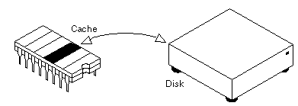
SMART Caching
When data is found in the cache, it is called a cache hit, and the effectiveness of a cache is judged by its hit rate. Many cache systems use a technique known as smart caching, in which the system can recognize certain types of frequently used data.
The strategies for determining which information should be kept in the cache constitute some of the more interesting problems in computer science.
The Intel 80486 microprocessor, for example, contains an 8K memory cache, and the Pentium has a 16K cache. Such internal caches are often called Level 1 (L1) caches. Most modern PCs also come with external cache memory, called Level 2 (L2) caches. These caches sit between the CPU and the DRAM.
Like L1 caches, L2 caches are composed of SRAM but they are much
larger.

Slide 29
SECONDARY MEMORY
Auxiliary memory /Auxiliary storage/ Secondary storage/ Secondary memory/ External memory, is used to store a large amount of data at lesser cost per byte than primary memory.
They are less expensive than primary memory.
The most common form of auxiliary memory devices used in consumer systems are:
  Flash Memory (Eg. Pen Drive)
  Optical Discs (Eg. CD,DVD,Blu-Ray Disk)
  Magnetic Disks (Eg. Hard Disk, Magnetic Tape)
Forms of Auxiliary Memory
i) FLASH MEMORY / FLASH STORAGE DEVICE
Flash memory: An electronic non-volatile computer storage device that can be electrically erased and reprogrammed, and works without any moving parts. A version of this is implemented in many Apple notebooks. Eg. PenDrive

Slide 30
ii) OPTICAL DISC DEVICE /OPTICAL STORAGE
Optical disc: Its a storage medium from which data is read and to which it is written by lasers. Optical disks can store much more data—up to 6 gigabytes (6 billion bytes)—than most portable magnetic media, such as floppies.
CD (Compact Discs- Optical storage)
Compact Disc (CD), is a digital optical disc data storage format.
Compact Disk (CD)
(CD-ROM) : Compact Disc-Read Only Memory
(CD-R)
(CD-RW)
: Compact Disc- Recordable
: Compact Disc- Re-Writable
DVD (digital optical disc storage)
DVD is a digital optical disc storage format, invented and developed by Moserbaer ,Philips, Sony, Toshiba, and Panasonic in 1995. DVDs offer higher storage capacity than CDs while having the same dimensions.
DVD-ROM Pre-recorded DVDs are known as Digital Video Disc-Read Only Memory,
because data can only be read and not written or erased.
DVD-R and DVD+R Blank recordable DVD discs (DVD-R and DVD+R) can be recorded once using a DVD recorder and then function as a DVD-ROM.
DVD-RW, DVD+RW ,DVD-RAM can be recorded and erased multiple times.
BLUE RAY DISCS (Digital Optical Discs)
They can store data on both sides of the disc. A single-layer disc can hold 25GB. A dual-
layer disc can hold 50GB. Ultra HD BluRay Disc can store almost 100GB of data.

Slide 31
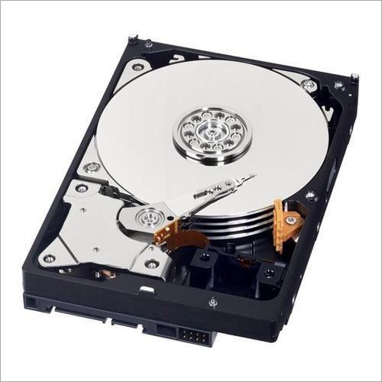
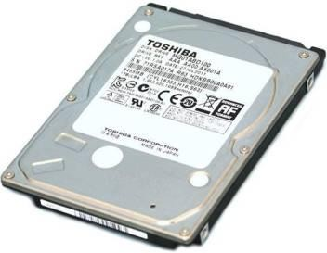
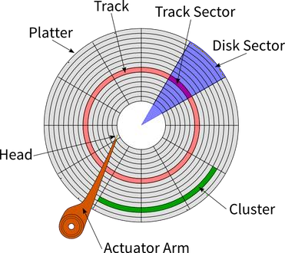
III) Magnetic Media: HARD DISK (Secondary Device)
Each disk consists of platters, rings on each side of each platter called tracks, and sections within
each track called sectors
. A sector is the smallest physical storage unit on a disk, almost always 512 bytes in size for hard disk drives (HDDs) and 2048 bytes for CD-ROMs and DVD-ROMs.

Slide 32


Interconnections of Functional components of a
Extra knowledge
computer system : THE SYSTEM BUS
System bus provides the electronic path to connect major functional components of a computer system through cables. This system bus helps in the passing of data and instructions among the various functional components
THE SYSTEM BUS
DATA BUS | It is the data carrying part of system bus
CONTROL BUS | It is the control instruction carrying part of a system bus.
ADDRESS BUS | It is the memory address carrying part of a system bus.
I/O BUS | It connects the Input , Output, and other external devices to the system.

Slide 33






























CLASSIFICATION OF SOFTWARE
OPERATING
SYSTEM SOFTWARE
SYSTEM LANGUAGE
PROCESSORS
ASSEMBLER
INTERPRETER
COMPILER
PACKAGES
SOFTWARE
CUSTOMIZED
S/W or
BUSINESS
S/W or TAILOR- MADE S/W
Text Editor Back up Utility Compression
Utility
Disk
Defragmenter
Antivirus
software
APPLICATION SOFTWARE
UTILITIES
DEVELOPER TOOLS

Slide 34

SYSTEM SOFTWARE
System Software controls internal operations of the computer system.
OPERATING SYSTEM: It is a program which acts as an interface between the user and the hardware.
Eg. Windows10, LINUX,UNIX,MANDRAKE,REDHAT
LANGUAGE PROCESSORS: A computer software which translates the source code into an object code(machine code).
As we know that computer understands only Binary level language (Machine level language), but the programmer writes in High Level Language which needs to be converted to Binary Language.
  SOURCE CODE: program code written in High Level Language (Eg. Python,C,C++,Java etc.)
  OBJECT CODE: Computer understandable code which can run on hardware very easily. (Binary Language/Machine Language)
TYPES OF LANGUAGE PROCESSORS:
i) Assembler ii) Compiler iii) Interpreter

Slide 35
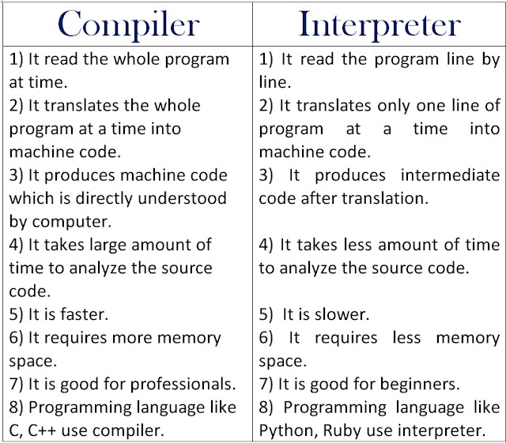
ASSEMBLER: Converts Assembly Level Language to Binary Level Language and vice-
versa
COMPILER: Converts High Level Language to Binary Level Language vice-versa in one go.
INTERPRETER: Converts High Level Language to Binary Level Language vice-versa line
by line.

Slide 36
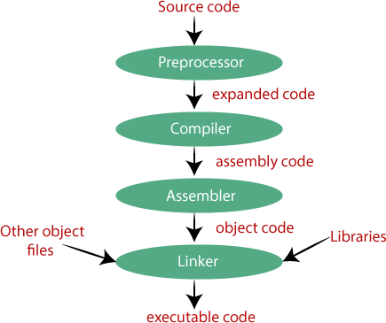
WORKING OF COMPILER….The compilation process
C / C++
Language
Preprocessing Phase removes extras (such as comments) from source code and adds all that is to be added/expanded so that code is completely ready for the next phase.
Analysis Phase (the front end phase) of compilation identifies all the tokens in the source code and creates a symbol table with it.
Synthesis phase (he back-end phase) parses the source code and generates syntax tree out of it. Once the code is error free, the compiler converts into intermediate code that is in the form of assembly level instructions.
Assembly phase receives the assembly level instructions and then converts it into object code (machine code).
Linking Phase all the required libraries are linked with the object code by the Linker(a part of the compiler). Finally, the Code has become executable (.exe file), which is the final object code with libraries ready for its execution in memory.
(.exe file)

Slide 37



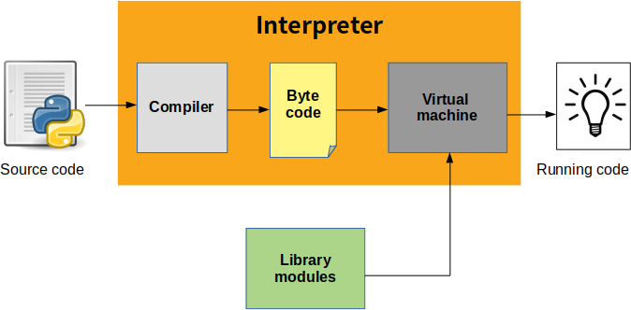

WORKING OF INTERPRETER…The Interpretation process
Fetches 2nd line of source code after successful execution of the 1st line of code in object code. And this process continues for each line. Hence, Interpreter is always required in he memory to run the code
101101
110110
101010
111011
Code Line 1
Code Line 2
Code Line 3
Code Line 4
Object Code
(Running code)
Execute one line of code, if error free then it proceeds to analyse and convert the 2nd line of code.
For every line of
code it does in the same way.

Slide 38
APPLICATION SOFTWARE
Application Software is the set of programs used to (run/ execute/ carry out operations ) for a specified application.
PACKAGES: General software which are designed in a way to be used by individual users in the manner it suits their needs and requirements.
→Word processing software
→Spreadsheets
→ Database management system
→Desktop publishing software
→Graphics, multimedia and presentation applications

Slide 39
APPLICATION SOFTWARE
→Word processing software
Word processing package is a package that processes textual matter and creates organized and flawless documents. Many word processors are available in the market.Some popular ones are wordstar, word, wordperfect, softword, etc.

Slide 40
APPLICATION SOFTWARE
→Electronic spreadsheet
an electronic spreadsheet is a program that accepts data in a tabular form(in rows and columns) and allows users to manipulate/calculate/analyze data in the desired manner. Many spreadsheet packages are available in the market. some popular ones are Lotus 1-2-3,excel,QuattroPro etc.

Slide 41
APPLICATION SOFTWARE
→DBMS
A database management (DBMS) is a package that can handle and manage bulk of stored data. Like other packages there are numerous DBMSs flocking the market. some popular ones are oracle,access etc.

Slide 42
APPLICATION SOFTWARE
→Desktop publishing Packages
The software that handles page layout by combining the functions of a traditional typesetter and a layout artist, is known as desktop publishing software.

Slide 43
APPLICATION SOFTWARE
→Graphics, Multimedia and Presentation Applications
Graphics software :
The application software that manipulates images is known as graphics software and the software that incorporates images,text,sound,computer animation and video sequences is known as multimedia software.
Presentation Graphics software:
The application software that can create professional looking visual aids is called presentation graphics software.

Slide 44
APPLICATION SOFTWARE
Application Software is the set of programs used to (run/ execute/ carry out operations ) for a specified application.
UTILITIES: These are the application programs that help the computer in housekeeping functions like backing up disk or scanning and cleaning for viruses or arranging information in an optimum way to increase efficiency of the system. Eg. Text Editor, Backup Utility, Compression Utility, Antivirus, Disk Defragmenter

Slide 45

UTILITIES
Text Editor: It helps to edit,cut,copy,paste text. Eg. Notepad,Wordpad
Backup Utility: We need to keep a backup of our data and information to safeguard them from losing either accidental or intentional. For eg. Backup kept in Pendrive, CD, DVD, HardDisk
Compression Utility: The data and information in files or folders can be kept in a compressed form so that, they occupy less space and can be retrieved in the original form after decompressing. Eg. WinZip,WinRar
Antivirus : Virus are the malicious program which affects the normal working of a computer system by eating up disk space, deleting files etc. So, to ovecome the problem of Virus, we need Antivirus to remove viruses from the system. Eg. QuickHeal,E-scan,Kaspersky etc.
Disk Defragmenter: It increase data access speed by rearranging files
stored on a disk to occupy contiguous storage locations, a technique
called defragmentation. Defragmentation is the process of reorganizing the data stored on the hard drive so that related pieces of data are put back together, all lined up in a continuous fashion. Free blocks together, Corrupted files together and same kind of blocks together in the hard drive.

Slide 46

APPLICATION SOFTWARE
Application Software is the set of programs used to (run/ execute/ carry out operations ) for a specified application.
3) CUSTOMISED SOFTWARE/ BUSINESS SOFTWARE: Readymade software which are tailor-made to fit exactly the need and purpose of the user (business customer). Eg. Inventory Management System, Hotel Management System.
4) DEVELOPER TOOLS/SOFTWARE TOOLS: The set of pre-written codes/functions/libraries or classes etc. available to programmers for the purpose of development of new programs or codes. Eg. Numpy Library in Python, Matplotlib Library in Python

Slide 47



Working With
OS

Slide 48

CONTENTS
Operating System Basics
Operating System
Operating System Objectives
Services Provided by the Operating System
Functions of Operating Systems

Slide 49
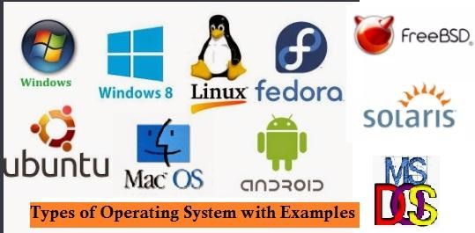
OPERATING SYSTEM
Operating system is a system software which provides
interface between the user and the hardware.
A program that controls the execution of application programs
  An interface between applications and
hardware
Operating System Objectives
Convenience
  Makes the computer more convenient to use
Efficiency
  Allows computer system resources to be used in an efficient manner
Ability to evolve
  Permit effective development, testing, and introduction of new system functions without interfering with service

Slide 50
Functions of Operating Systems
Provides a user interface
  How a user interacts with a computer
  Require different skill sets
Run programs/Software
Manage hardware devices
Storage management(Organize files and folders)
Process management
(Job scheduling & management)
Memory Management
Error detection and response
(hardware/software errors)

Slide 51
Providing a User Interface
Graphical user interface (GUI)
  Most common interface
    Windows, OS X, Gnome, KDE
  Uses a mouse to control objects
  Uses a desktop metaphor
  Shortcuts open programs or documents
  Open documents have additional objects
  Task switching
  Dialog boxes allow directed input

Slide 52
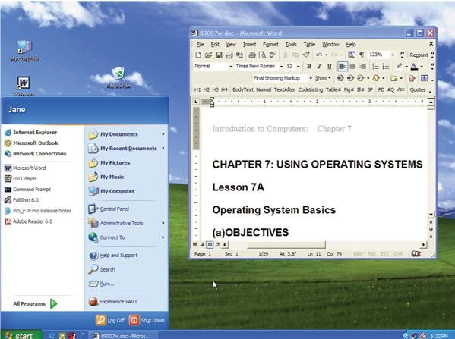
Graphical User Interface

Slide 53
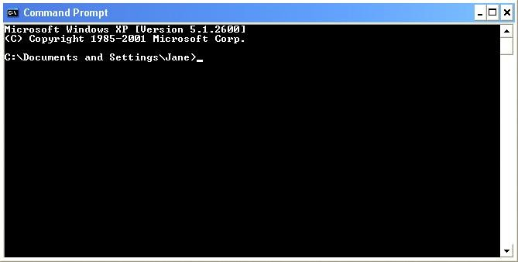
Providing a User Interface
Command line interface
  Older interface
    DOS, Linux, UNIX
  User types commands at a prompt
  User must remember all commands
  Included in all GUIs
Press start button of your desktop/laptop and write cmd to see this command prompt

Slide 54
Running Programs
Extra knowledge
Many different applications supported
System call
– Provides consistent access to OS features
Share information between programs
Managing Hardware
Programs need to access
hardware
Interrupts
  CPU is stopped
  Hardware device is accessed
Device drivers control the hardware
Copy and paste
Object Linking and Embedding
Organizing Files and Folders
Organized storage
Long file names
Folders can be created and nested
All storage devices work consistently

Slide 55




